Slide 1
DR.SNSRCAS, CBE
SUBJECT: CLOUD TECHNOLOGY FUNDAMENTALS
COURSE CODE:21UCA501 UNIT - IV
TITLE: Working with the Google App Engine
YEAR: III SEMESTER 2022-2023 (ODD)

Slide 2
Working with the Google App Engine
Google App Engine (GAE) is a Platform as a Service (PaaS) cloud-based Web hosting service on Google’s infrastructure.

Slide 3
Working with the Google App Engine
GAE home page at http://code.google.com/intl/en/appengine/. This service allows developers to build and deploy Web applications and have Google manage all the infrastructure needs, such as monitoring, failover, clustering, machine instance management.

Slide 4
Working with the Google App Engine
For an application to run on GAE, it must comply with Google’s platform standards, which narrows the range of applications that can be run and severely limits those applications’ portability.

Slide 5
Working with the Google App Engine
GAE supports the following major features:
Dynamic Web services based on common standards
Automatic scaling and load balancing
Authentication using Google’s Accounts API
Persistent storage, with query access sorting and transaction management features
Task queues and task scheduling
A client-side development environment for simulating GAE on your local system
One of either two runtime environments: Java or Python

Slide 6
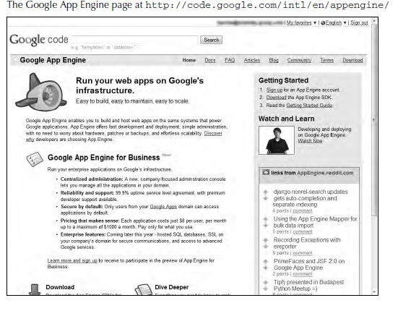

Slide 7
Working with the Google App Engine
Google App Engine currently supports applications written in Java and in Python.
The service is meant to be language agnostic.
A number of Java Virtual Machine languages are compliant with GAE, as are several Python Web frameworks that support the Web Server Gateway Interface (WSGI) and CGI.

Slide 8
Working with the Google App Engine
Google has its own Web app framework designed for use with GAE. The AppScale (http://appscale. cs.ucsb.edu/) open-source framework also may be used for running applications on GAE.

Slide 9
Working with the Google App Engine
To encourage developers to write applications using GAE, Google allows for free application development and deployment up to a certain level of resource consumption.

Slide 10
Working with the Google App Engine
Google uses the following pricing scheme:
CPU time measured in CPU hours is $0.10 per hour.
Stored data measured in GB per month is $0.15 per GB/month.
Incoming bandwidth measured in GB is $0.10 per GB.
Outgoing bandwidth measured in GB is $0.12 per GB.
Recipients e-mailed is $0.0001 per recipient.

Slide 11
Thank You

